Slide 1
CS478 – Computatıonal geometry project
Implementation of Two Delaunay Triangulation Algorithms and Comparing Their Performance
by Serhat Gürgenyatağı (21903288)

Slide 2
Maın purpose of the program
Create and visualize Delaunay Triangulations for different point sets using two different algorithms:
Randomized Incremental Algorithm
Divide-and-conquer Algorithm

Slide 3
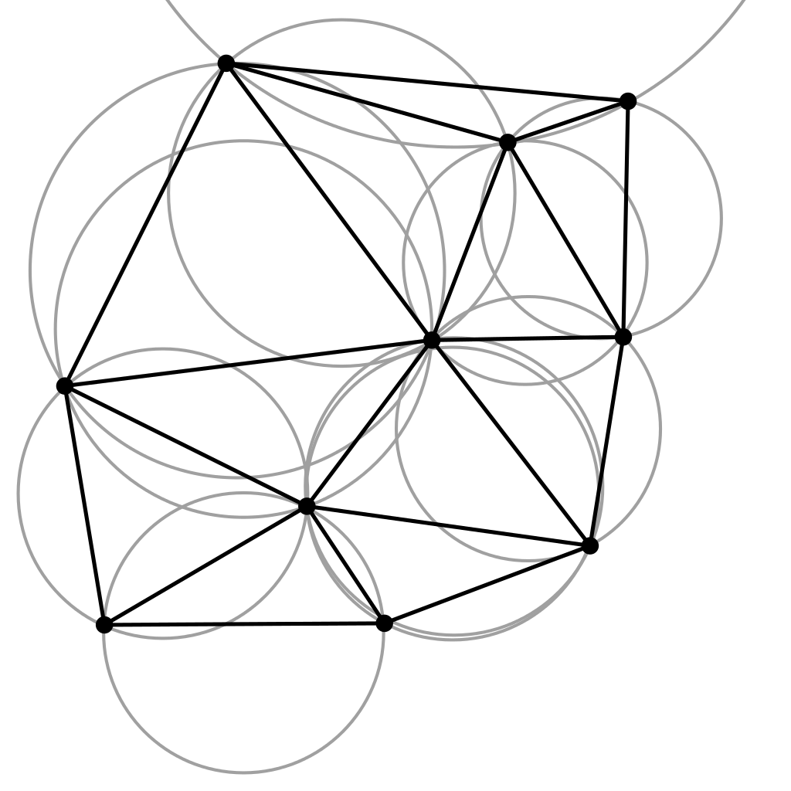
What ıs delaunay trıangulatıon?
Triangulation of a given set of discrete points, not all colinear, such that none of the circumcircles of the triangles includes a point inside.

Slide 4
Algorıthms

Slide 5
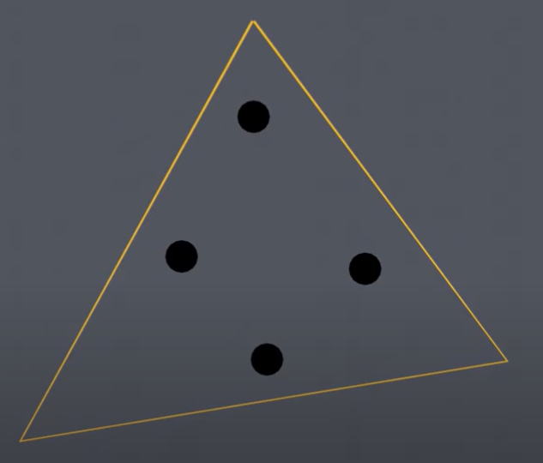
Randomızed ıncremental algorıthm
Form a super triangle outside the points

Slide 6
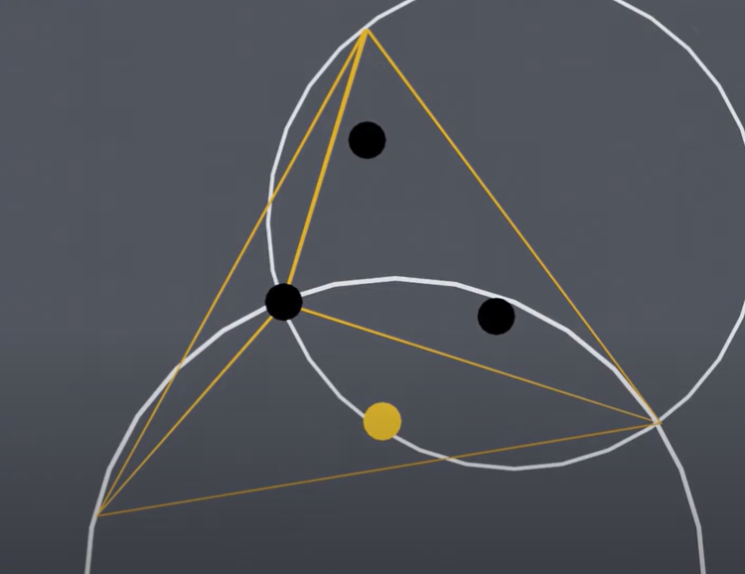
Randomızed ıncremental algorıthm
Consider triangles whose circumcircles include a point inside “illegal triangles”

Slide 7
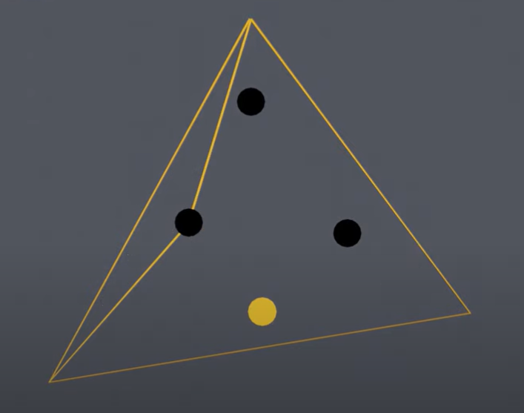
Randomızed ıncremental algorıthm
Delete edges shared by two illegal triangles

Slide 8
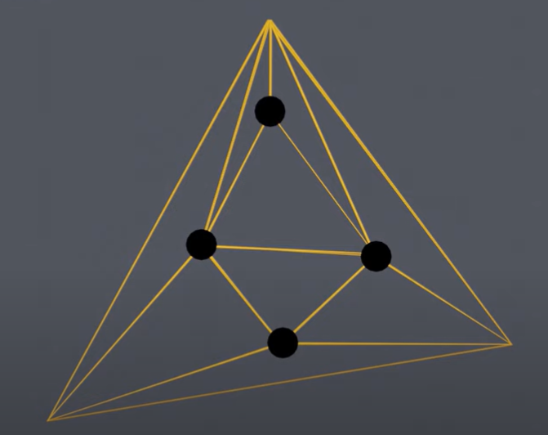
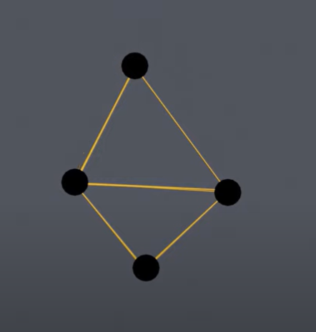
Randomızed ıncremental algorıthm
Repeat the process for all points
Remove the vertices of the super triangle and edges incident upon them

Slide 9
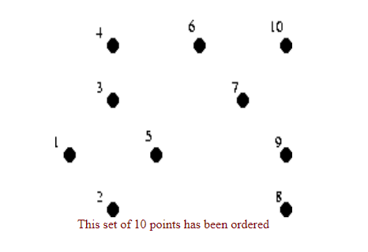
DIVIDE AND CONQUER ALGORITHM
Sort the points in increasing order of x-coordinates

Slide 10
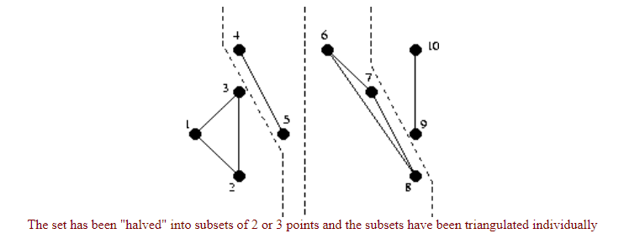
DIVIDE AND CONQUER ALGORITHM
Divide the points into subsets of no more than three points

Slide 11
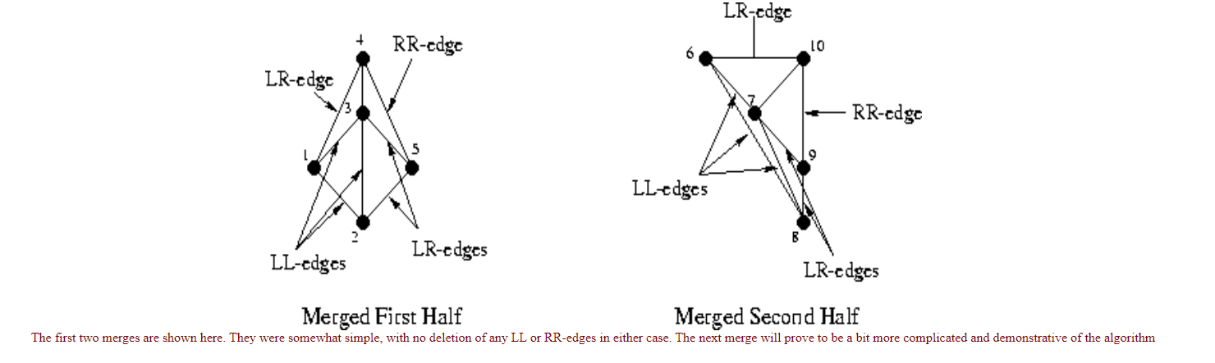
DIVIDE AND CONQUER ALGORITHM
Merge the subsets with their former halves

Slide 12
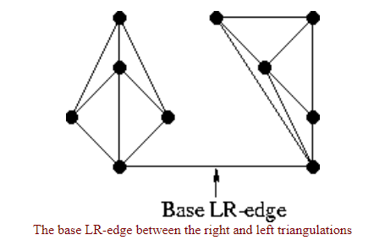
DIVIDE AND CONQUER ALGORITHM
When merging, delete the Left-Left and Right-Right edges, and insert Left-Right edges

Slide 13
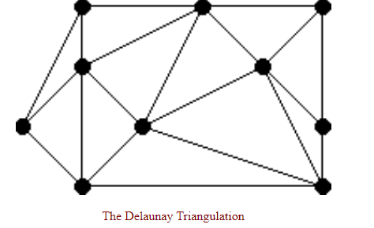
DIVIDE AND CONQUER ALGORITHM
Once the last two halves are merged successfully, the triangulation is complete

Slide 14
The ımplementatıon

Slide 15

The implementation was done in Python 3
tkinter
numpy
matplotlib

Slide 16
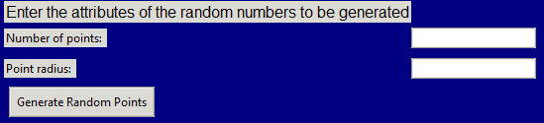
features
Generating sets of 2D points

Slide 17
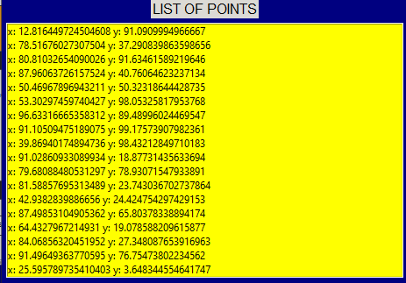
features
List the existing points

Slide 18
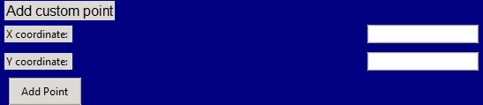

features
Add & Remove points

Slide 19

features
Triangulate using one of the two algorithms

Slide 20
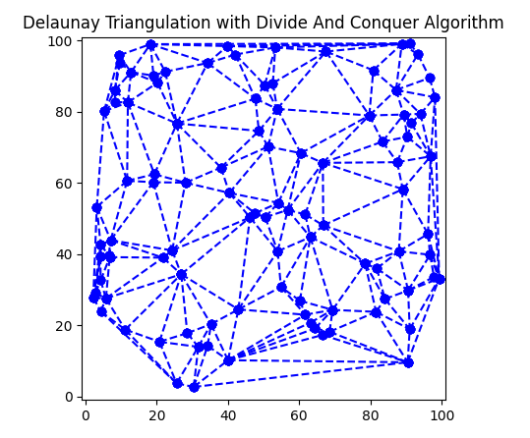
features
Visualize the triangulation

Slide 21
Thanks for listening! Questions?

